Slide 1

Music Store Data Analysis using SQL
Presented By :
Revanth T
Batch No: 533

Slide 2
Agenda
Business Problem
Business Problem Statement
Introduction
Objective of the Project
Music Store Database – Tables Overview
ER Diagram
SQL query results
Challenges Faced
Final business insights
Business Recommendations
Conclusion
Q&A

Slide 3
Business Problem
The music store generates sales across multiple countries, cities, genres, artists, and customer segments, resulting in a large volume of transactional data.
Without proper analysis, it becomes difficult to understand customer preferences, identify top-performing markets, and recognize high-value customers and popular music genres.

Slide 4
Business Problem Statement
The music store operates across multiple countries and offers a wide range of artists and genres. However, the company lacks clear visibility into:
Which markets generate the highest revenue
Which customers contribute the most to sales
Which music genres are most popular across regions
Which artists drive the strongest engagement and purchases

Slide 5
Introduction
The Music Store Data Analysis project provides an opportunity to apply SQL concepts to a real-world dataset.
By working with a music store database, you will practice creating tables, defining relationships, importing data, and writing complex queries to answer business questions.
This project reinforces skills in database design, data manipulation, and analytical query writing.

Slide 6
Objective of the Project
The objective of this project is to analyze the music store database using SQL to:
Identify top revenue-generating cities and countries
Determine the most valuable customers overall and per country
Analyze customer spending behavior across artists
Identify the most popular music genres by region
Identify top-performing artists based on track count
The goal is to transform raw transactional data into actionable business insights.

Slide 7
Music Store Database – Tables Overview
Employee – Stores employee details, job title, level, and reporting structure.
Artist – Stores artist names.
Album – Links albums to artists.
Track – Stores song details (album, genre, duration, price).
Genre – Classifies tracks by music category.
MediaType – Defines track format (e.g., audio type).
Invoice – Records customer purchase transactions.
Invoice Line – Stores track-level purchase details (price × quantity).
Playlist – Contains playlist names.
Playlist Track – Maps tracks to playlists (many-to-many).
Customer – Contains customer contact info and assigned support representative.

Slide 8
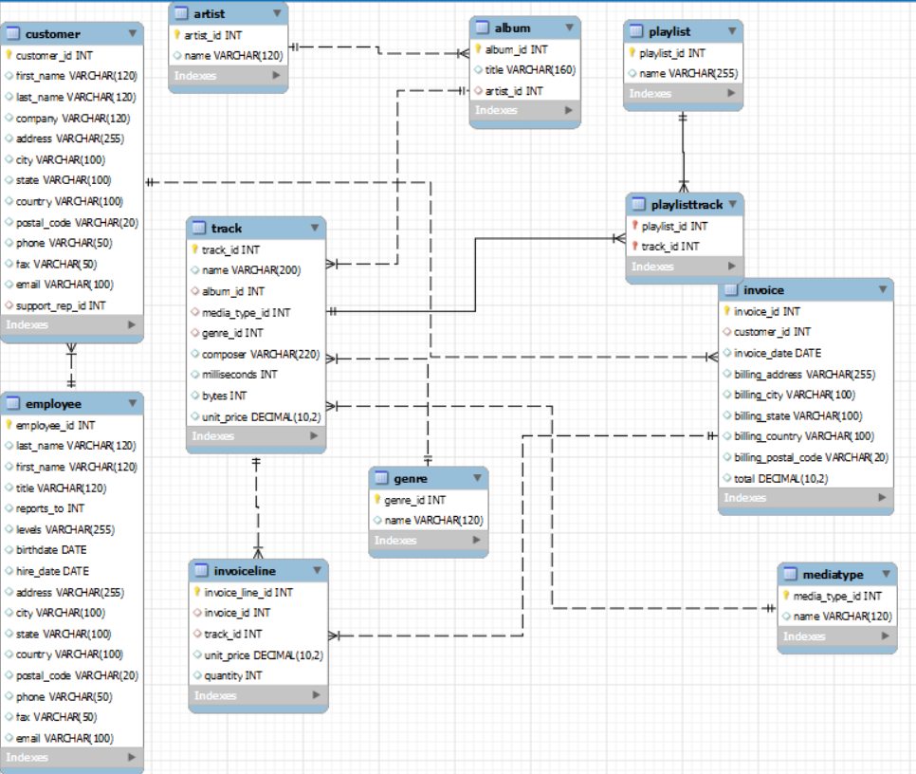
ER DIAGRAM

Slide 9
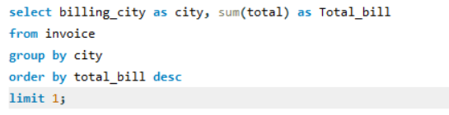
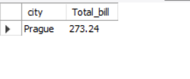
Which city generates the highest total revenue and should be selected to host a promotional music festival?
Prague generates the highest total revenue with a total billing of 273.24, making it the top-performing city.
Since Prague contributes the maximum revenue, it is the most suitable city to host a promotional music festival.

Slide 10

Which customer has spent the highest total amount and is therefore considered the best customer?
CREATE VIEW top_customer_by_total_bill AS
SELECT
i.customer_id,
c.first_name,
c.last_name,
SUM(i.total) AS total_bill
FROM invoice AS i
JOIN customer AS c
ON i.customer_id = c.customer_id
GROUP BY i.customer_id, c.first_name, c.last_name
ORDER BY total_bill DESC
LIMIT 1;
SELECT * FROM top_customer_by_total_bill;
František Wichterlovái (Customer ID: 5) has the highest total spending of 144.54, making them the top customer.
Since the ranking is based on SUM(total), this customer is identified as the best customer by total purchase value.

Slide 11
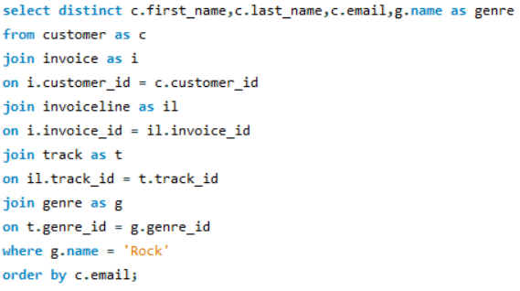
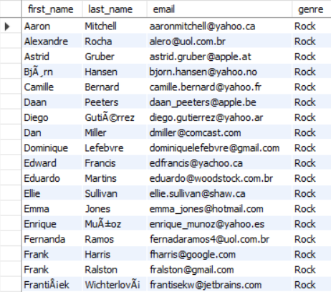
Retrieve the email ID, first name, last name, and genre of all customers who listen to Rock music.
The query identifies customers associated with the Rock genre by joining customer, invoice, invoice line, track, and genre tables.
DISTINCT is used to ensure that each Rock music listener appears only once, even if they have purchased multiple Rock tracks.

Slide 12
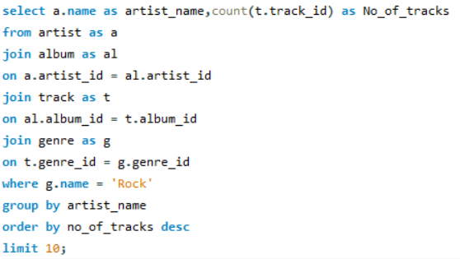
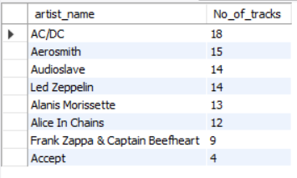
Which artists have produced the highest number of Rock music tracks in the dataset?
AC/DC has the highest number of Rock tracks (18), making them the top contributor in the Rock genre.
Other prominent Rock artists include Aerosmith (15 tracks) and Audioslave and Led Zeppelin (14 tracks each), indicating strong representation in the Rock category.

Slide 13
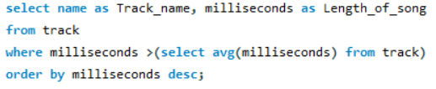
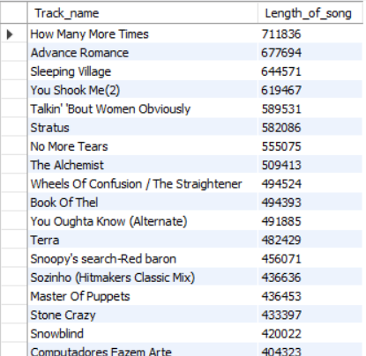
Return all the track names that have a song length longer than the average song length.-Return the Name and Milliseconds for each track
The query compares each track’s duration with the average track length and returns only those tracks that are longer than the average.
Results are sorted in descending order of milliseconds, highlighting the longest tracks first, with “How Many More Times” being the longest among them.

Slide 14
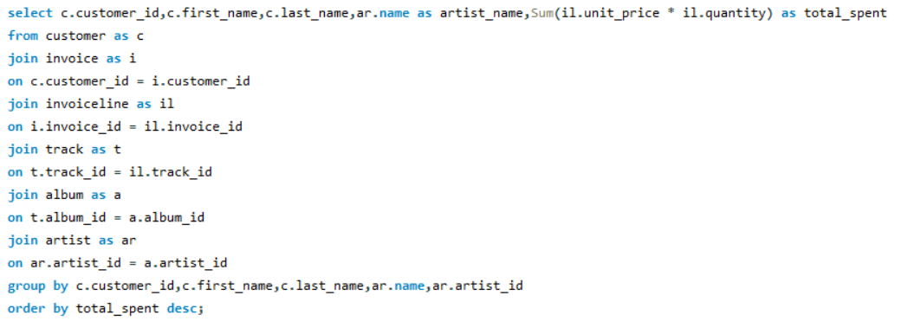
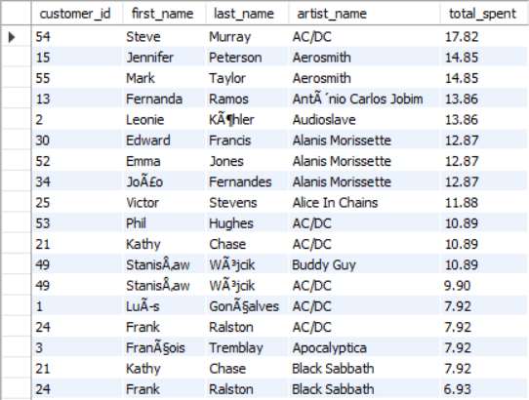
Calculate the total amount spent by each customer on individual artists.
The query computes the total amount spent by each customer on each artist using
SUM(il.unit price * il.quantity).
Results are grouped by customer and artist, allowing us to see which artists each customer has spent the most on, and are ordered by total spent in descending order.

Slide 15
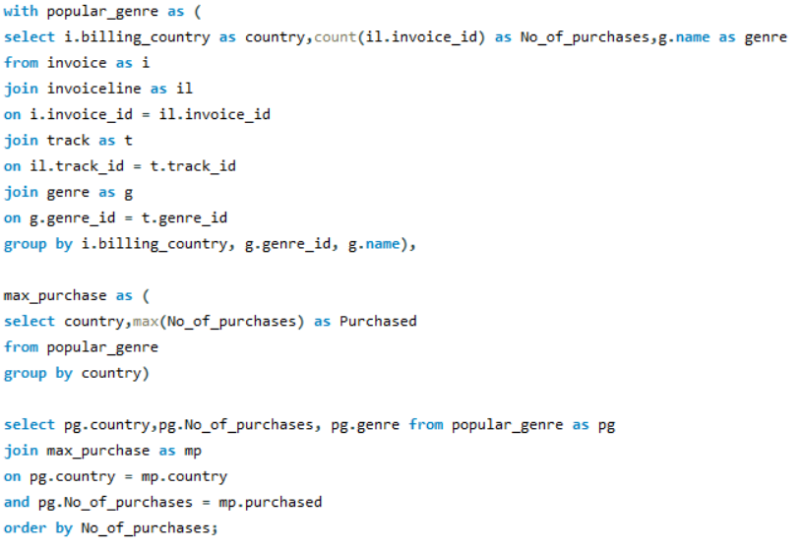
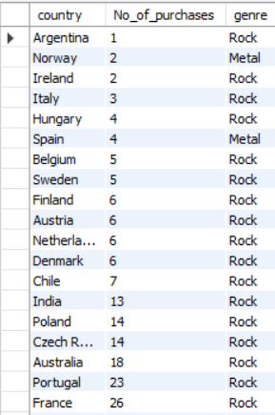
Identify the most popular music genre for each country based on the highest number of purchases.

Slide 16
For each country, the most popular genre is determined by counting the number of purchases (invoices) associated with each genre and selecting the genre with the maximum purchase count.
The results show that Rock is the most popular genre in the majority of countries, indicating it has the highest purchase volume across regions in the dataset.

Slide 17
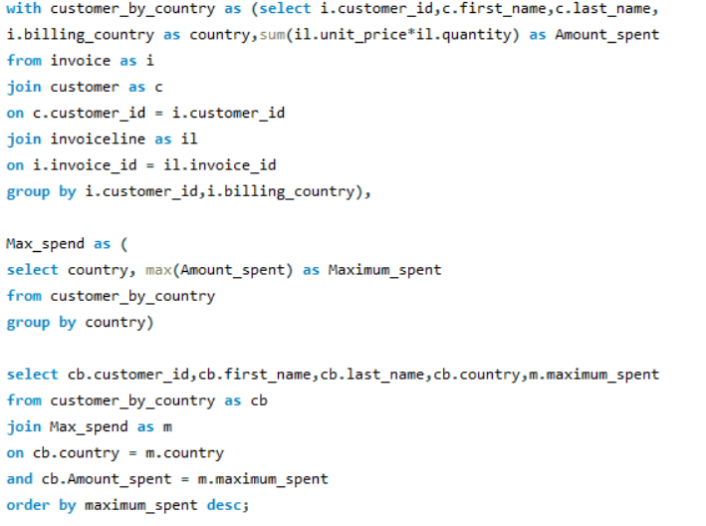
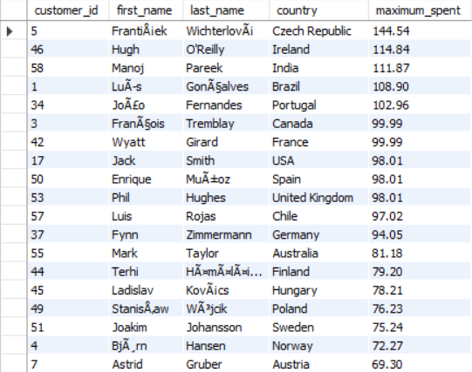
Determine the customer who has spent the highest total amount on music in each country.

Slide 18
For each country, the query calculates the total amount spent by each customer and then identifies the maximum spending value, selecting the customer(s) who match that amount.
The results highlight the top-spending customer per country, with spending levels varying across countries, and are ordered by the maximum amount spent in descending order.

Slide 19
Final Business Insights
Prague is the highest revenue-generating city → best location for promotional music events.
USA leads in invoice volume → strongest and most active market.
Rock is the most popular genre across most countries → primary focus for marketing campaigns.
Top Rock artists (e.g., AC/DC, Aerosmith) dominate the dataset → ideal for artist-led promotions.
High-spending customers contribute significantly to revenue → target them with loyalty and premium offers.

Slide 20
Business Recommendations
Focus marketing efforts on high-revenue markets such as Prague and countries with the highest invoice volumes (e.g., USA).
Promote Rock music aggressively, as it is the most popular genre across most countries.
Leverage top-performing artists (e.g., AC/DC, Aerosmith) for promotions, featured playlists, and campaigns.
Target high-value customers with loyalty programs, personalized offers, and exclusive access to content.

Slide 21
Conclusion
This analysis provides a clear understanding of customer behavior, revenue distribution, and genre preferences within the music store dataset.
The results show that revenue is concentrated in specific cities (such as Prague), the USA drives the highest transaction volume, and Rock is the dominant genre across most countries. Additionally, certain customers and artists contribute significantly to overall revenue.
By focusing on high-revenue markets, promoting the most popular genre (Rock), engaging top artists, and targeting high-spending customers, the company can optimize marketing efforts, improve customer retention, and maximize overall profitability.

Slide 22


Slide 23

THANK YOU

